Slide 1

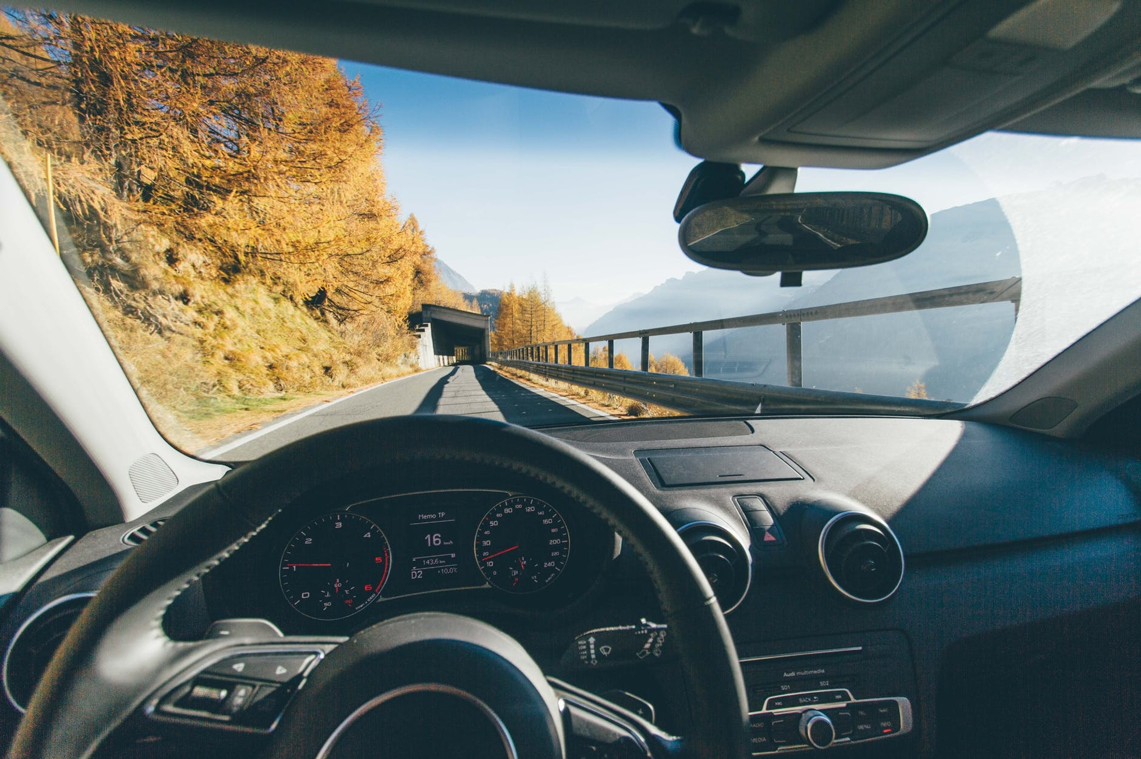
Factors Affecting Road Safety and SPER Debt Collection
in Queensland, 2021
Group 10| Nihlahtuzzahra | Jenlarp Jenlarpwattanakul
Jin Chai | Yifan Zhang | Mansi Mohan Darekar | YusiCheng

Slide 2
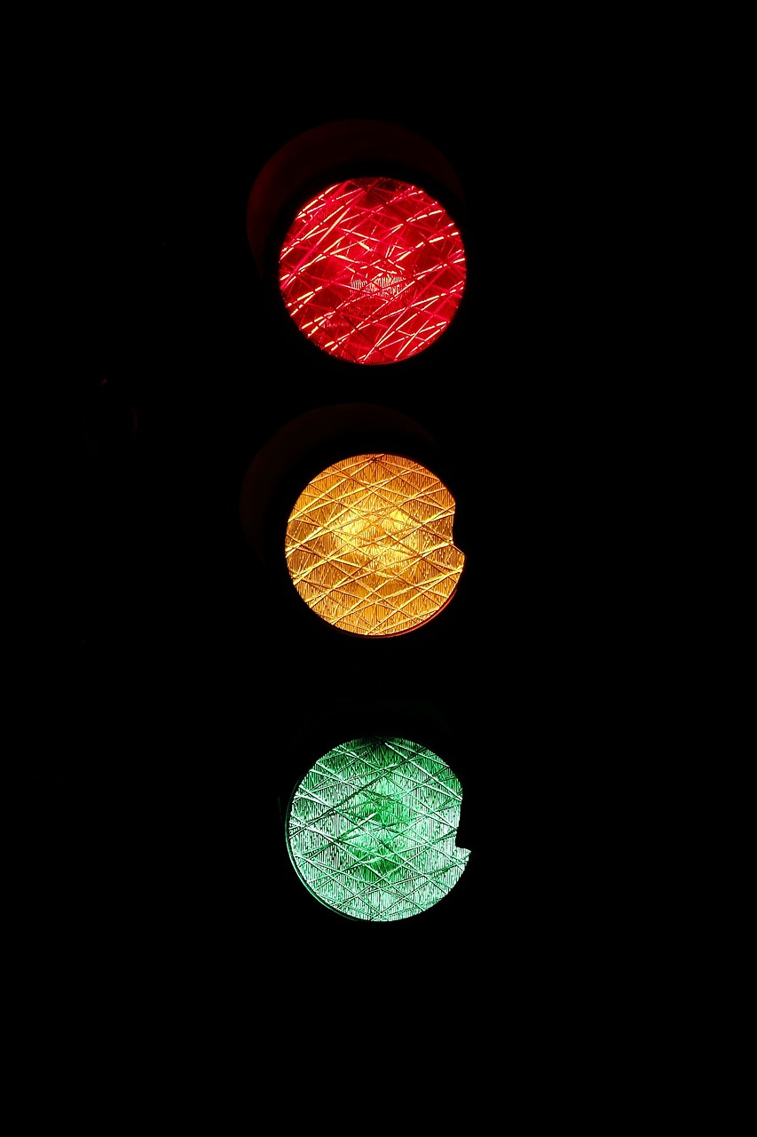
Problem Solving with Data
INTRODUCTION
Road accident and unpaid traffic fines (SPER Debts) are significant issues in Queensland. Understanding the factors is crucial for implementing effective intervention to improve road safety and debt collection
RESEARCH QUESTIONS
What are the main causes of car accidents in Queensland in 2021?
Does the installation of speed cameras necessarily lead to decrease in the number of crashes?
What are the most significant factors contributing to the SPER Debt by SA4 regions?
2

Slide 3
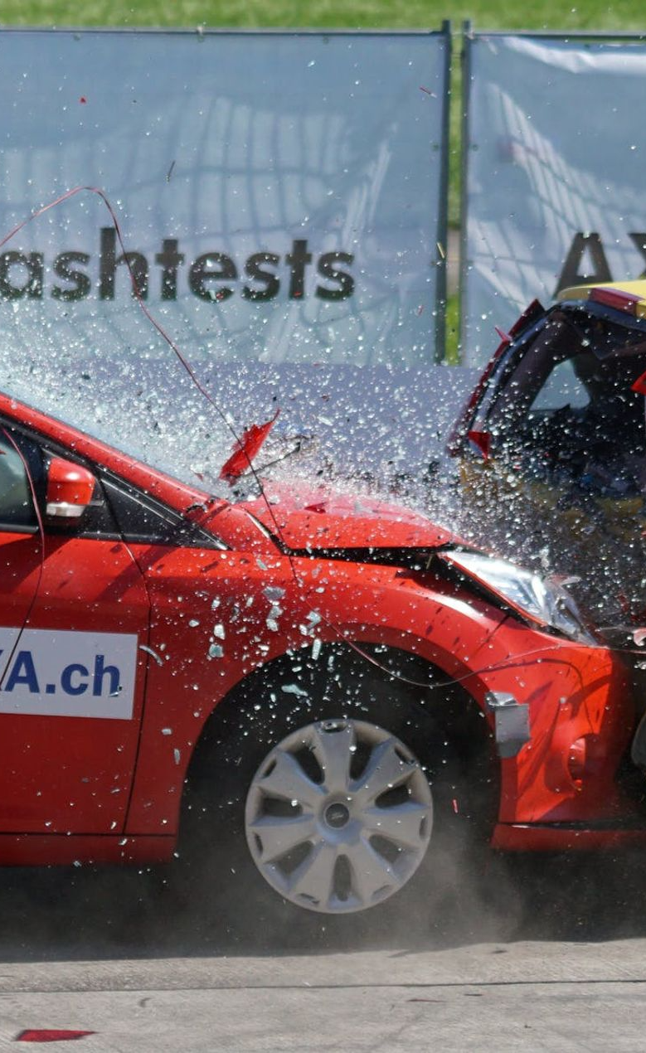


Getting The Data
The datasets were obtained from Open Data Portal Queensland Government
Crash Data
Factor of Crash
Camera Location
SPER Data
Keypoint
Crash Severity, Locations, Traffic Control, Speed Limit
Alcohol, Speed, Fatigued, Defective Vehicle
types of camera and its location
SPER by SA4 Regions, Number of Debtors, and top 10 offence
Size
Jan - Dec 2021
Jan - Dec 2021
Installed for 5 last year
Jan - Dec 2021
Data Type
Qualitative
Qualitative and Quantitative
Qualitative
Qualitative and Quantitative

Slide 4
1
Completeness
2
Accuracy
No Missing Values
Re-format crash location coordinates using decimal degrees format
Ensure all the camera coordinate location in Queensland, Australia
3
Consistency
4
Data Transformation
Ensure that statistical area 4 (SA4) consists of 19 areas
Year consistency
Converted string (Yes or No) to numeric (1 or 0) for Involvement Factor of Crash
Converted number of debts and outstanding balance (from string to numeric)
IS THE DATA FIT FOR USE?

Slide 5
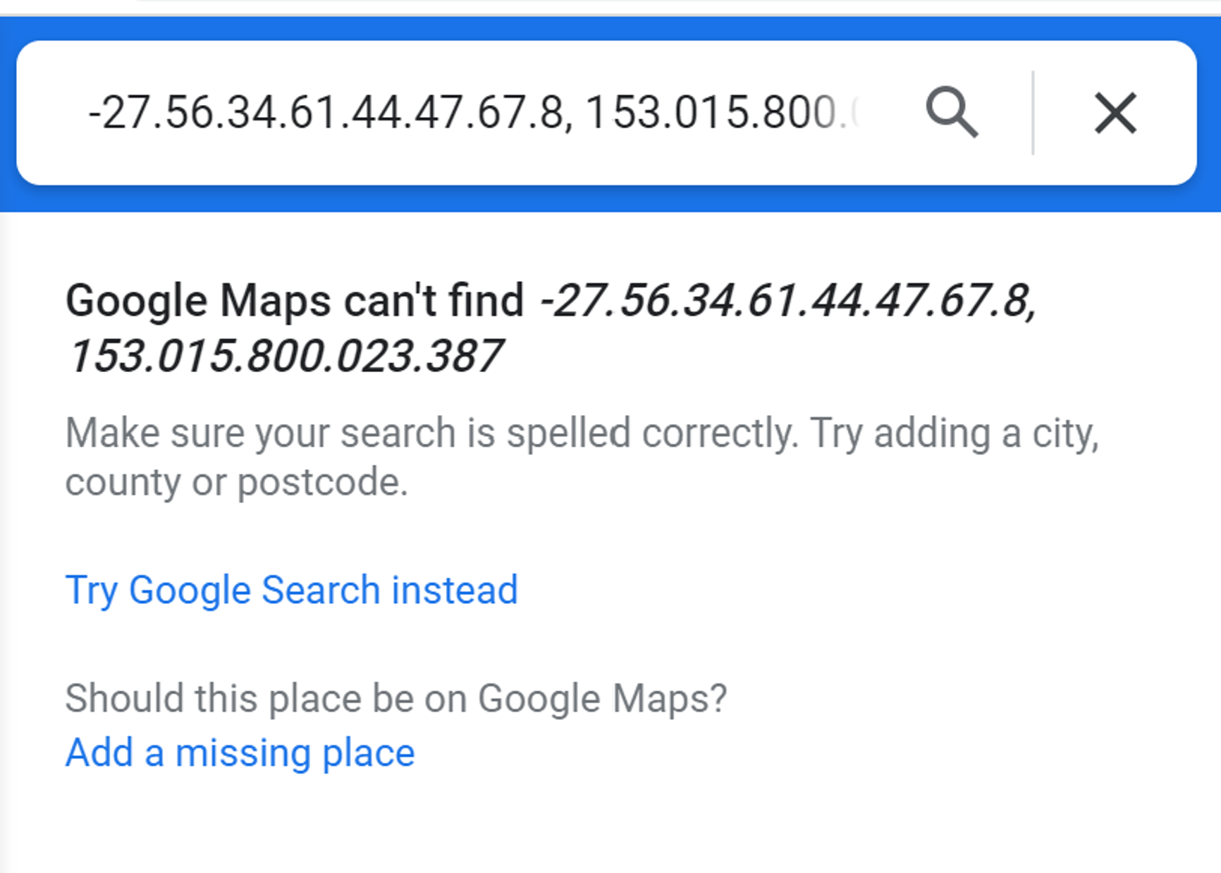
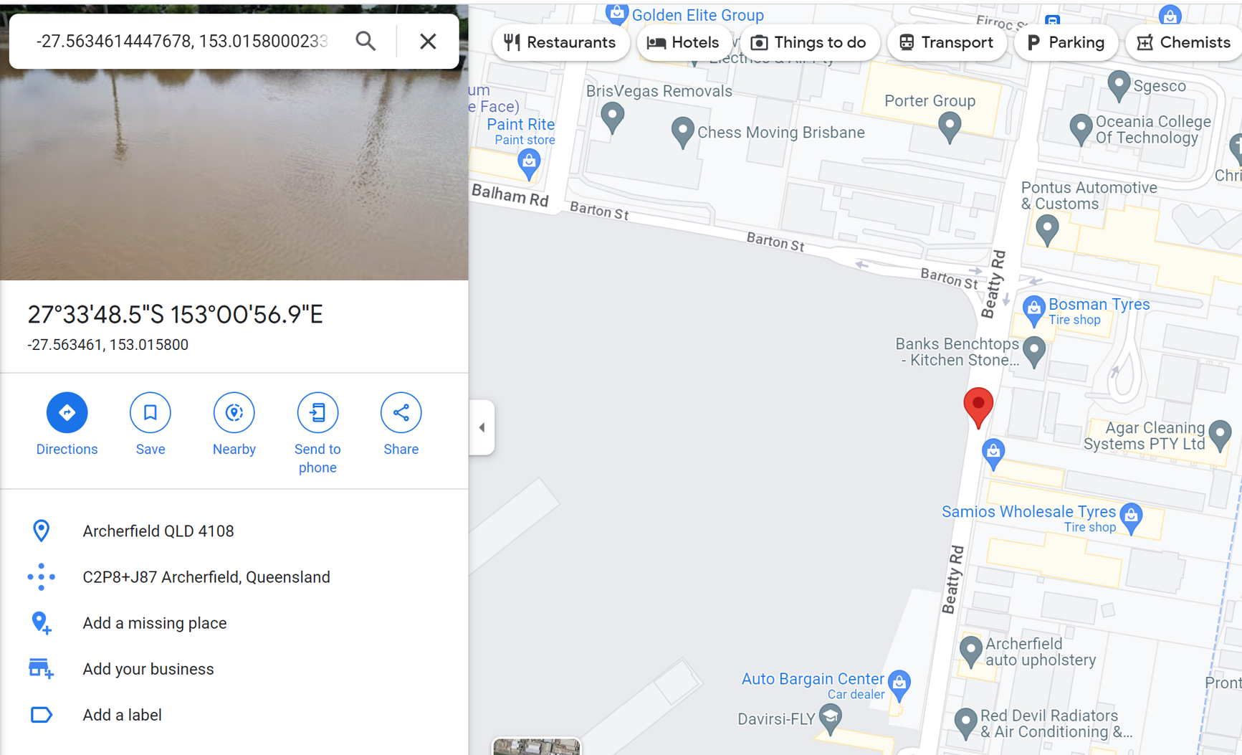


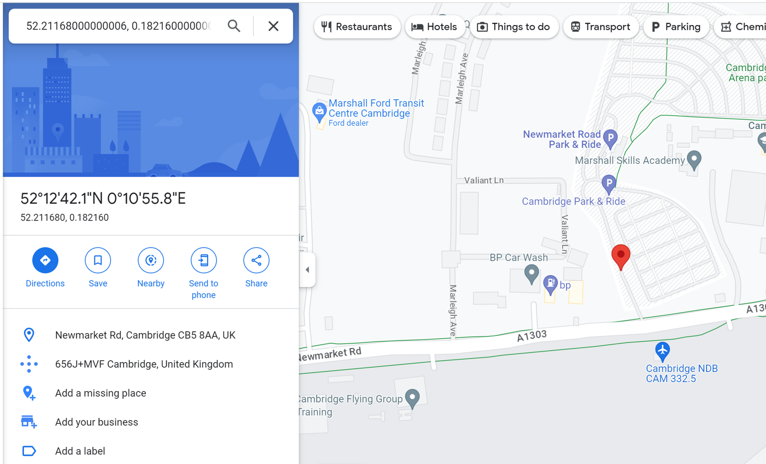
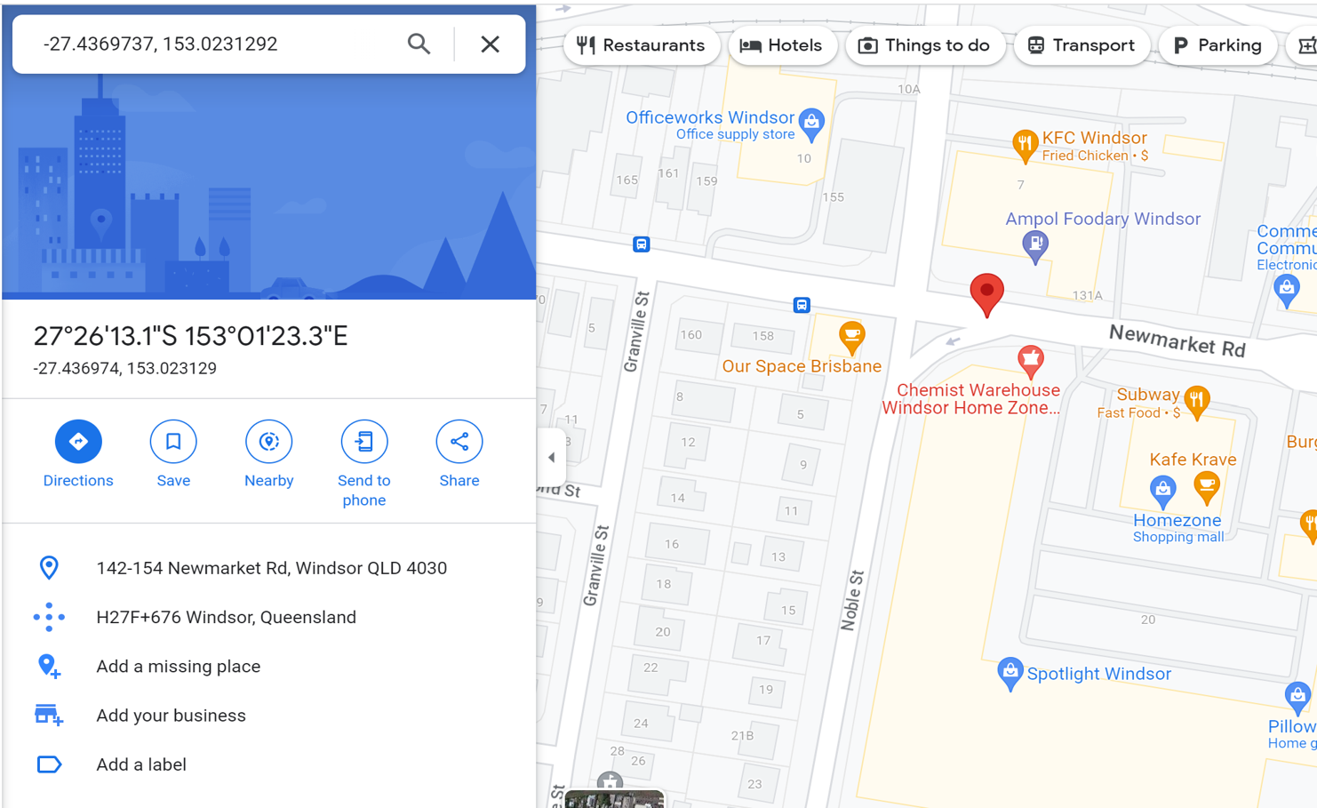


BEFORE RE-FORMAT
AFTER RE-FORMAT
NOT IN QLD
IN QLD

Slide 6
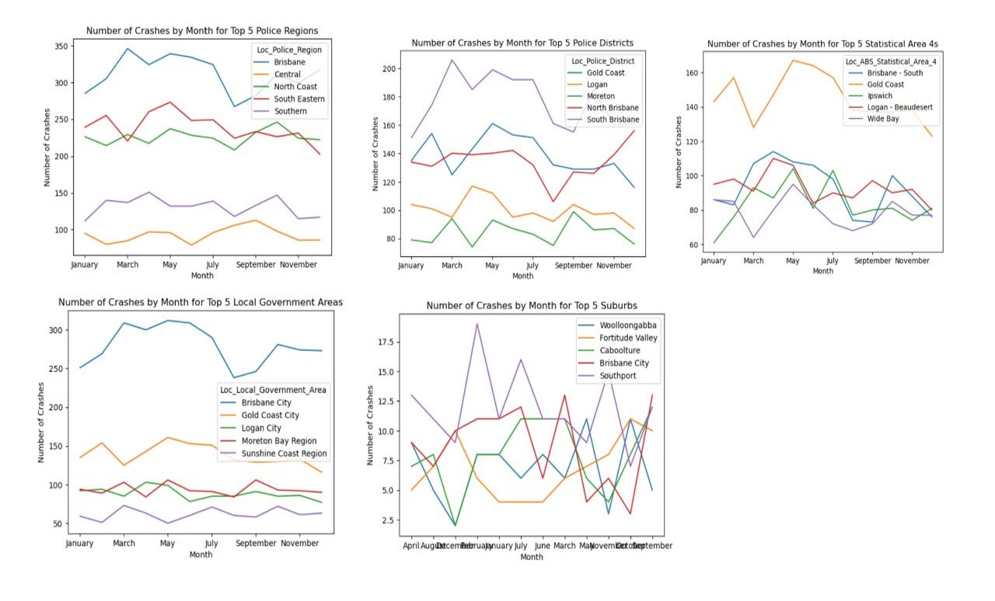
Crash Location in The Queensland
The number of crashes that occured accross all areas fluctuated significantly throught the year 2021
Most Crashes Happened in Local Government Areas:
1. Brisbane City
2. Gold Coast City
3. Logan City
4. Moreton Bay
5. Sunshine Coast

Slide 7
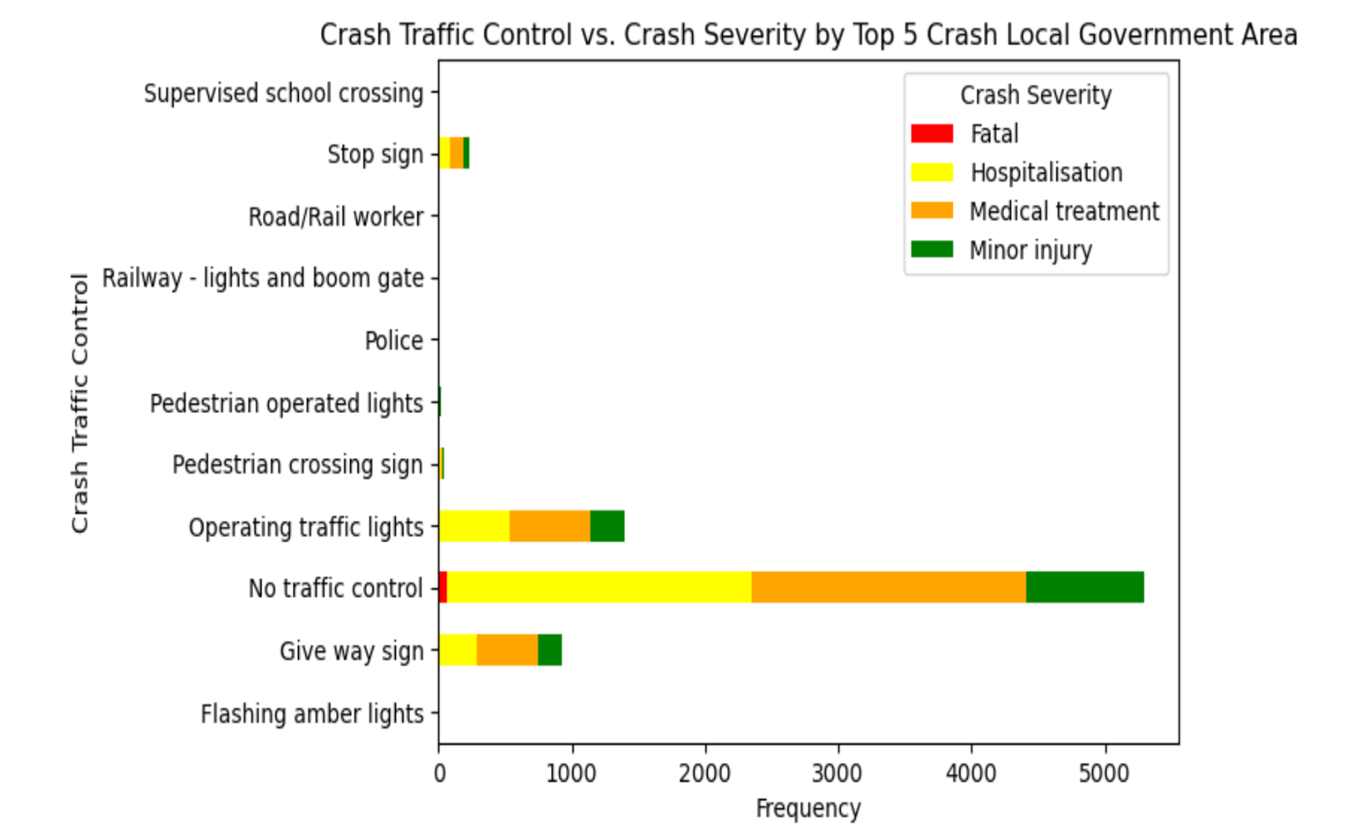
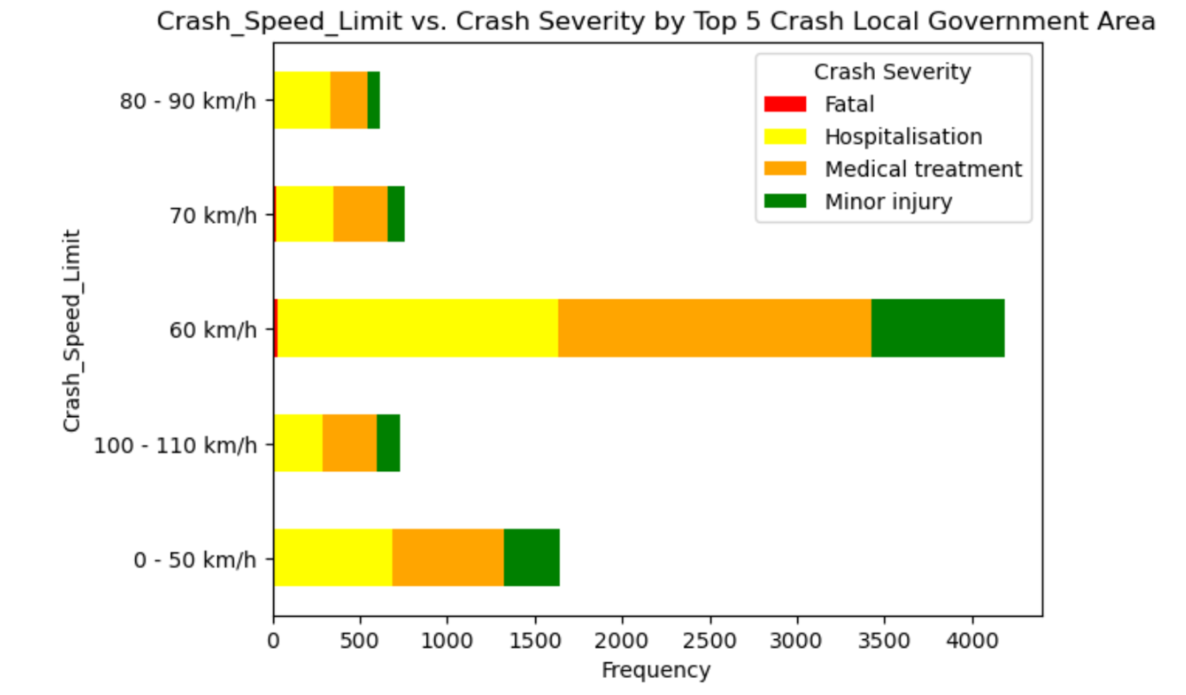
Contributed Factors to The Severity of Crashes
Three primary causes of crashes: no traffic control, operating traffic ligths, and give way signs
The highest number of crashes occured at 60 km per hour, rather than at speeds 100-110km per hours

Slide 8
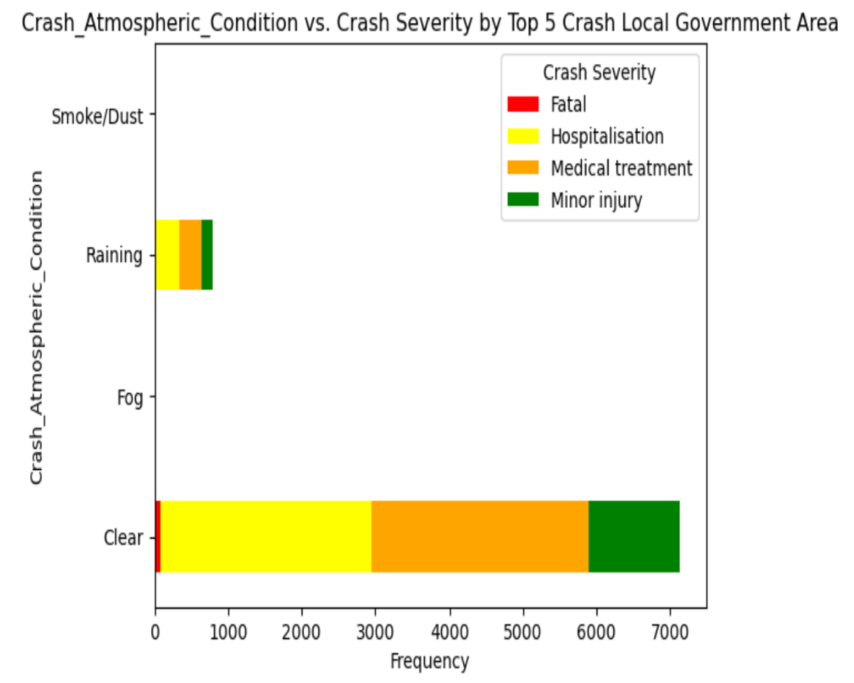
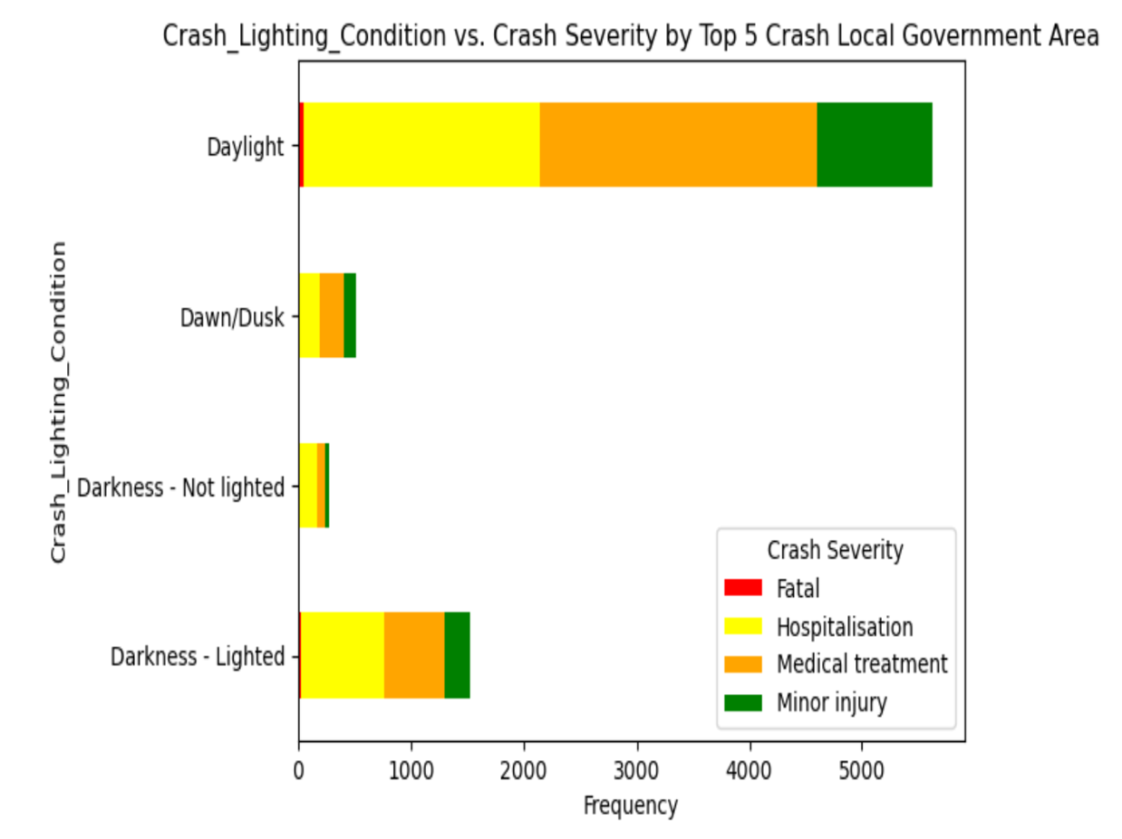
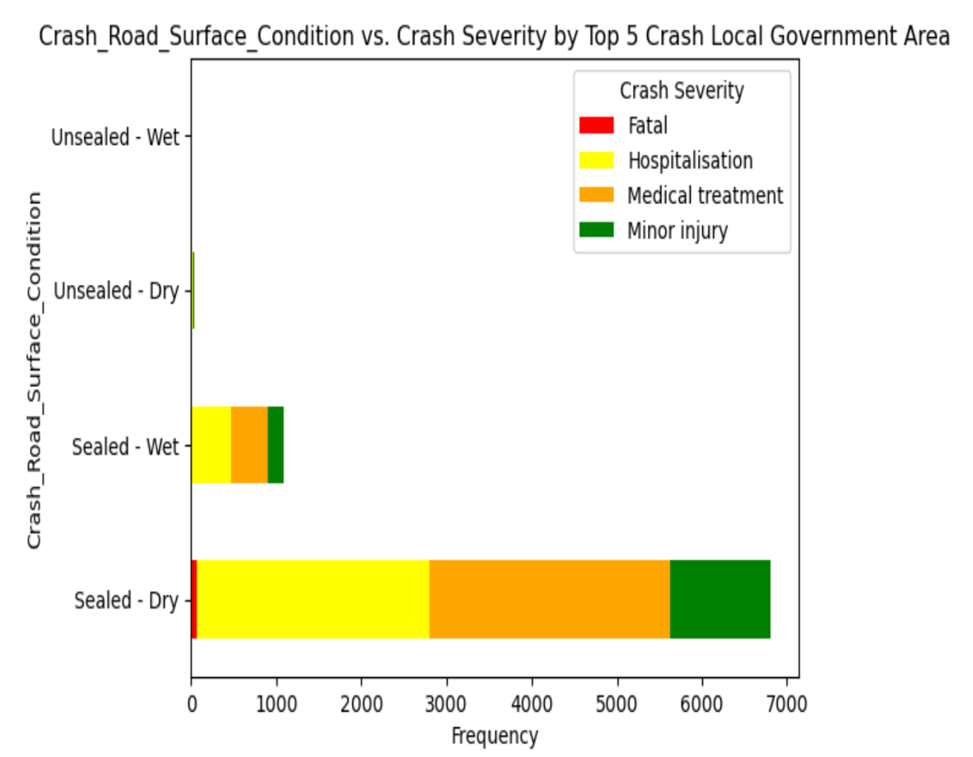
(Cont) Contributed Factors to The Severity of Crashes
The highest number of crashes occured during clear atmospheric and daylight clighting condition. Also, it most occured uunder the road surface conditions of sealed-dry.

Slide 9
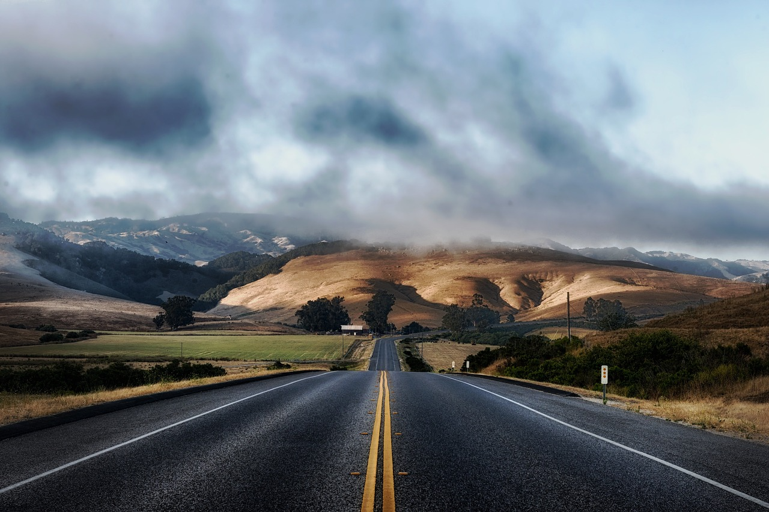
2021
Involvement factors to crash severity
hospitalization is the most prevalent crash severity resulting from:
Drink Driving
Driver Speed
71
64
Cases
Cases
Fatigued Driver
Defective Vehicle
40
40
Cases
Cases

Slide 10




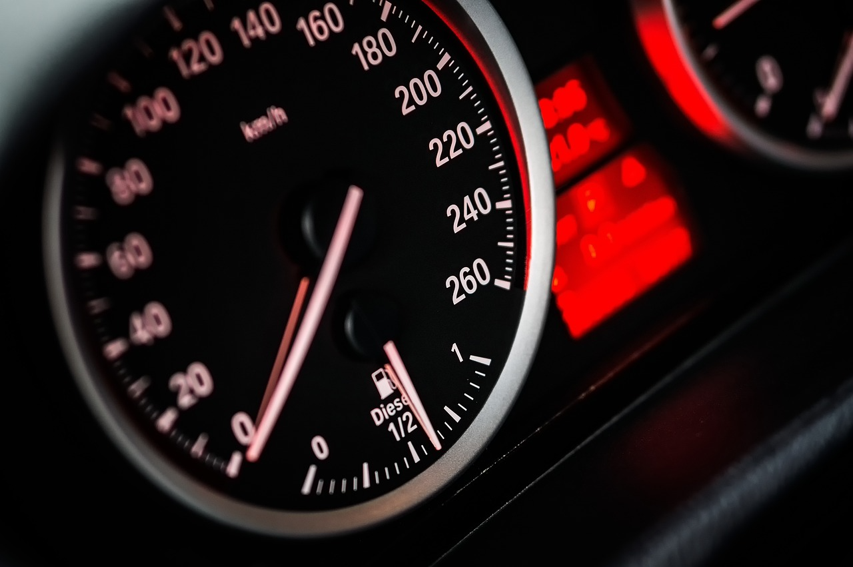

Association Strength Between Factors of Crash to Severity
using cramer's V to measure association strength between factor of crash to crash severity
factor of crash (X) : traffic control, speed limit, road surface, atmospheric condition, and lighting condition
involvement factors (X): drink driving, driver speed, fatigued driver, defective vehicle
Involving defective vehicles and drink driving are the two most strength predictors to the crash severity
"the strength of the associations is not particularly strong to the crash severity
the cramer's value range from 0.01 to 0.06
the cramer's value range from 0.07 to 0.08

Slide 11



Number of Debtors in ABS SA4
who have not pay the fines and penalties
Toowomba
12%
11%
Darling Downs
7%
Brisbane-east
The regions with the highest number of debts are Toowoomba, Darling Downs, and Brisbane East

Slide 12
Offence Groups Contributed to Outstanding Balance
15%
16%
11%
10%
23%
Tolling
Speeding
Driving
Vehicle
Speeding, Driving, and Tolling are the top three offenses that contribute the most to the outstanding balance

Slide 13
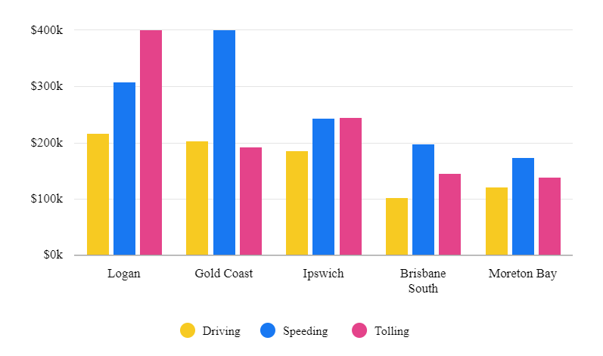
Outstanding Balance by Group of Offence
$6.673.647.000
total outstanding balance in Location SA4

Slide 14
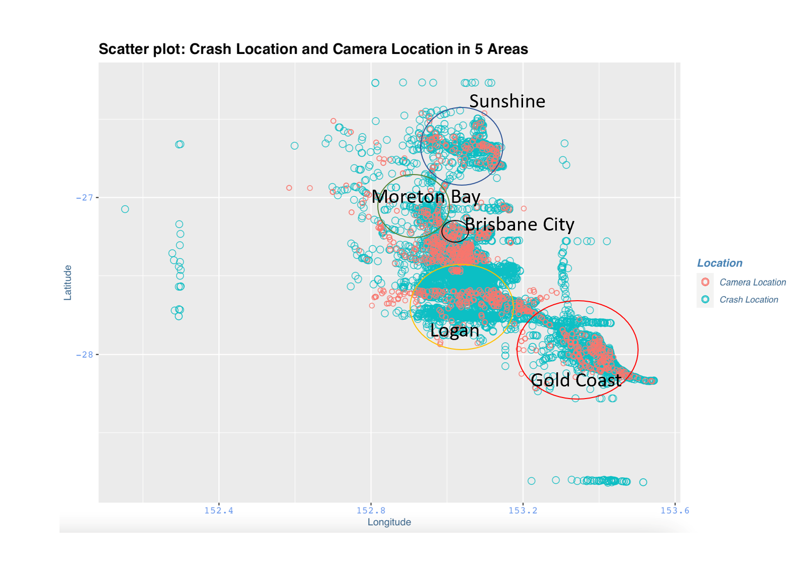
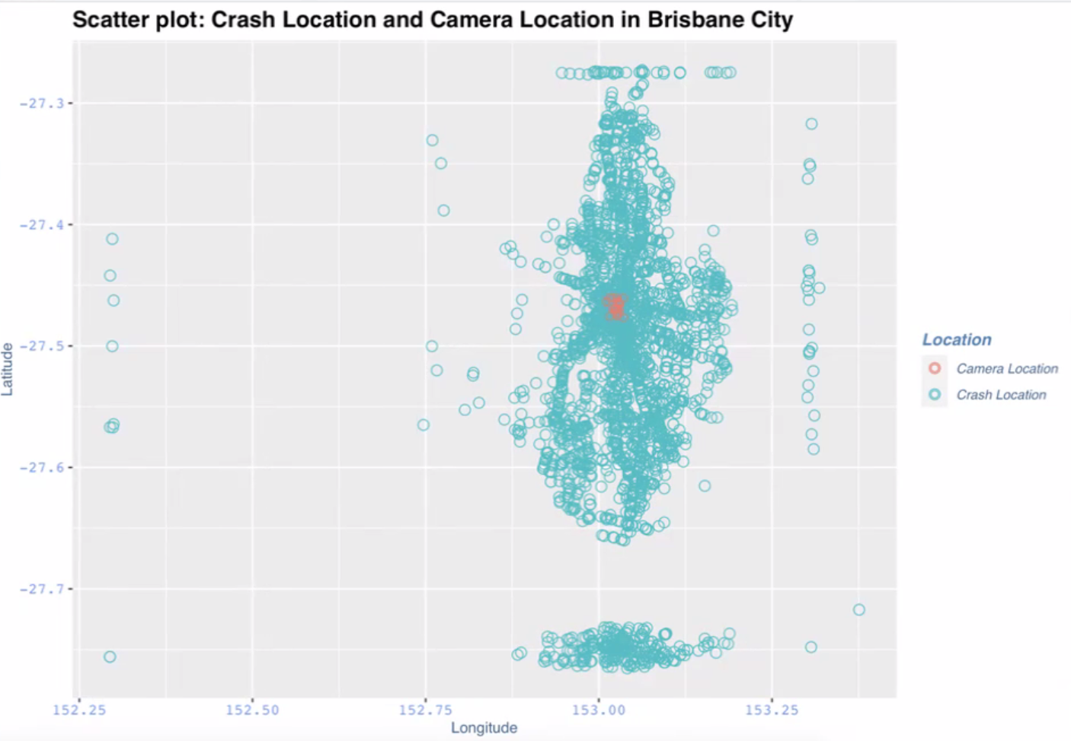
Speed Camera and Crash Location Mapping
in Local Area Government
In Brisbane City, the number of cameras is insufficient in comparison to the number of crashes that occur. There are a significant number of accidents that happen in areas where cameras are not present.
Brisbane: N: -27.460001, 153.014973 E: -27.463589, 153.035599 S: -27.480858, 153.029871 W: -27.467248, 153.010503

Slide 15
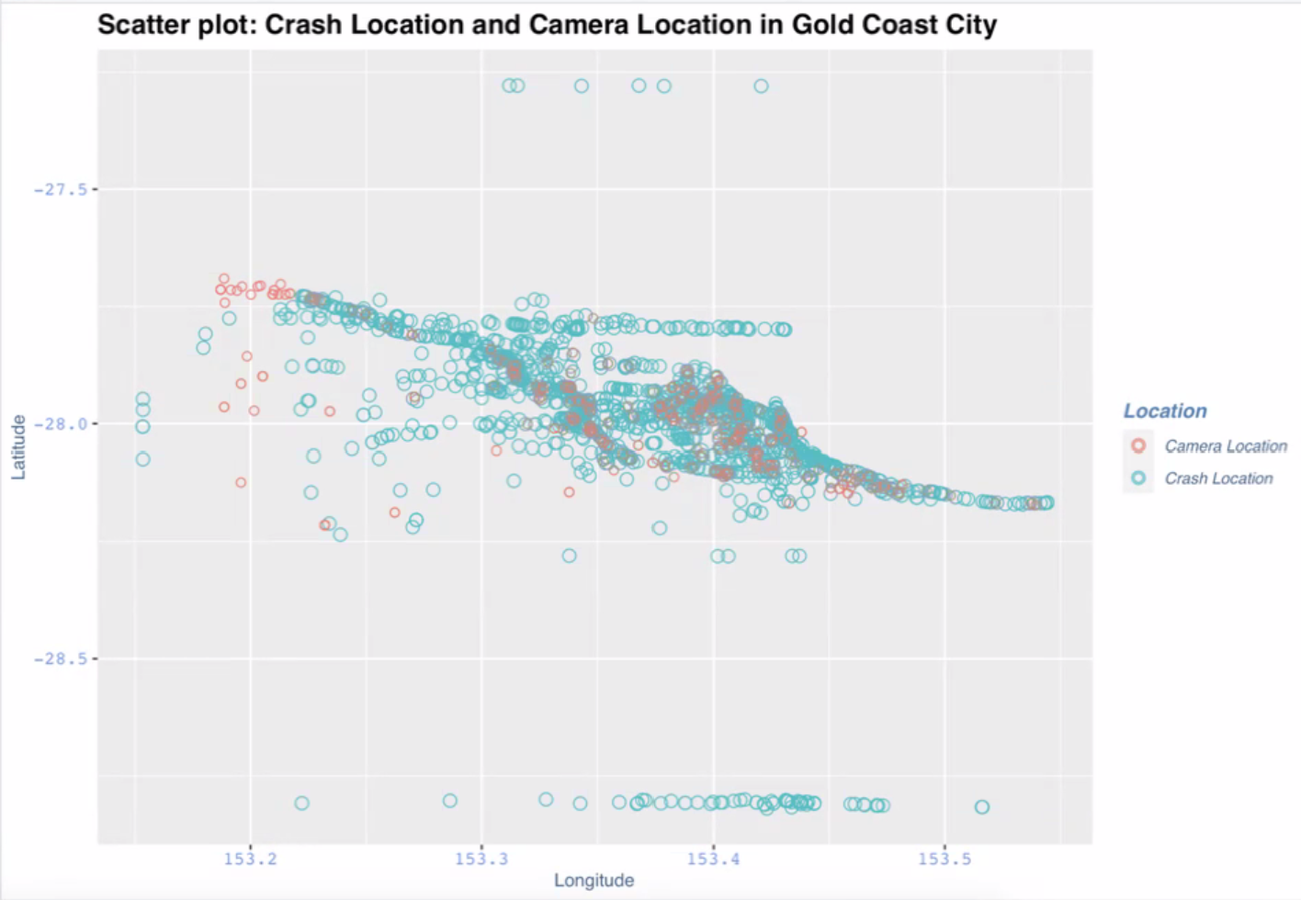
Speed Camera and Crash Location Mapping
in Local Area Government
In Gold Coast, although some cameras are present in locations where crashes occur, there are still incidents of crashes that happen without any camera coverage.
Gold coast: N: -27.690399, 153.255689 E: -28.164439, 153.551850 S: -28.265145, 153.232789 W: -28.192909, 153.184329

Slide 16
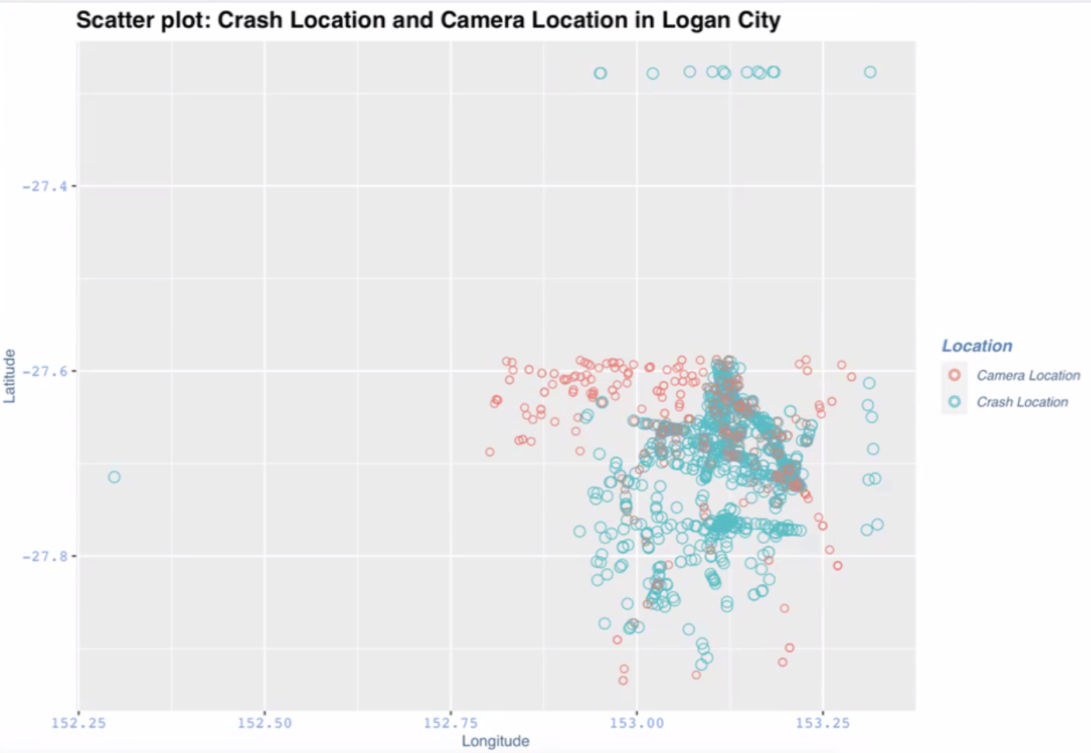
Speed Camera and Crash Location Mapping
in Local Area Government
In Logan City, also show that some cameras are present in locations where crashes occur, and there are still incidents of crashes that happen without any camera coverage.
Logan city: N: -27.587315, 153.123311 E: -27.688190, 153.290340 S: -27.938566, 153.069691 W: -27.839125, 152.799330

Slide 17
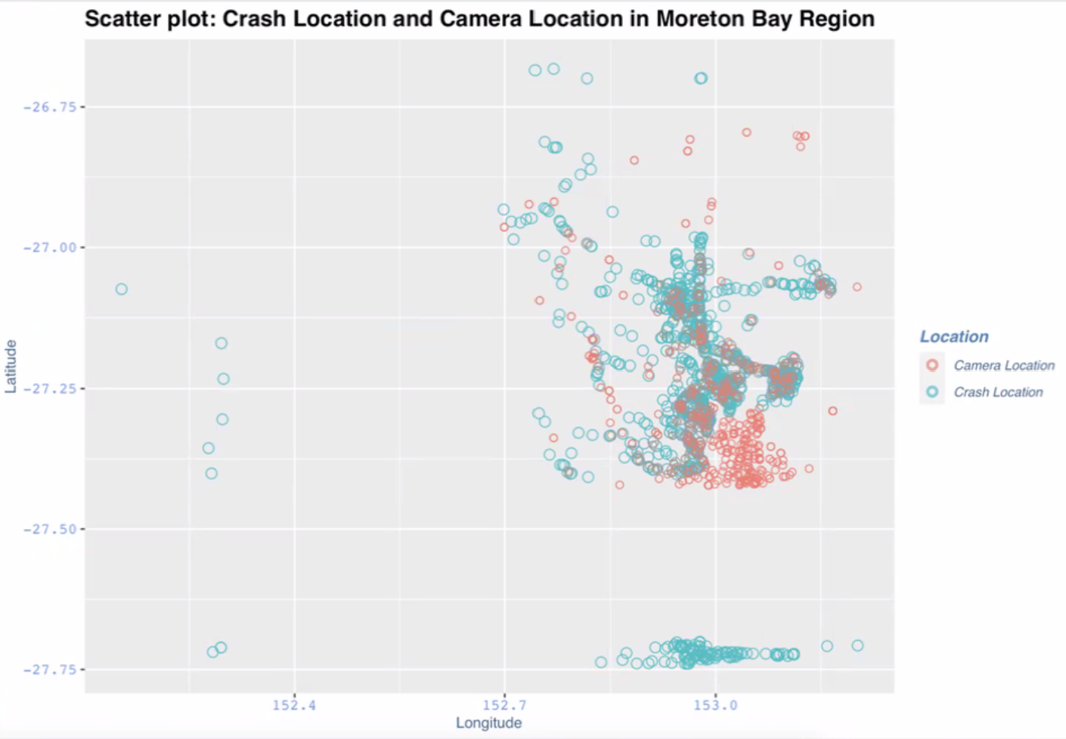
Speed Camera and Crash Location Mapping
in Local Area Government
In the Moreton Bay Region, it is apparent that cameras are present in some locations where crashes occur, yet many incidents of crashes still transpire without any camera coverage. On the other hand, there are areas where cameras exist, but no accidents have been recorded.
Moreton bay region: N: -26.792279, 152.761080 E: -27.081725, 153.207221 S: -27.422384, 152.861159 W: -26.955319, 152.651273

Slide 18
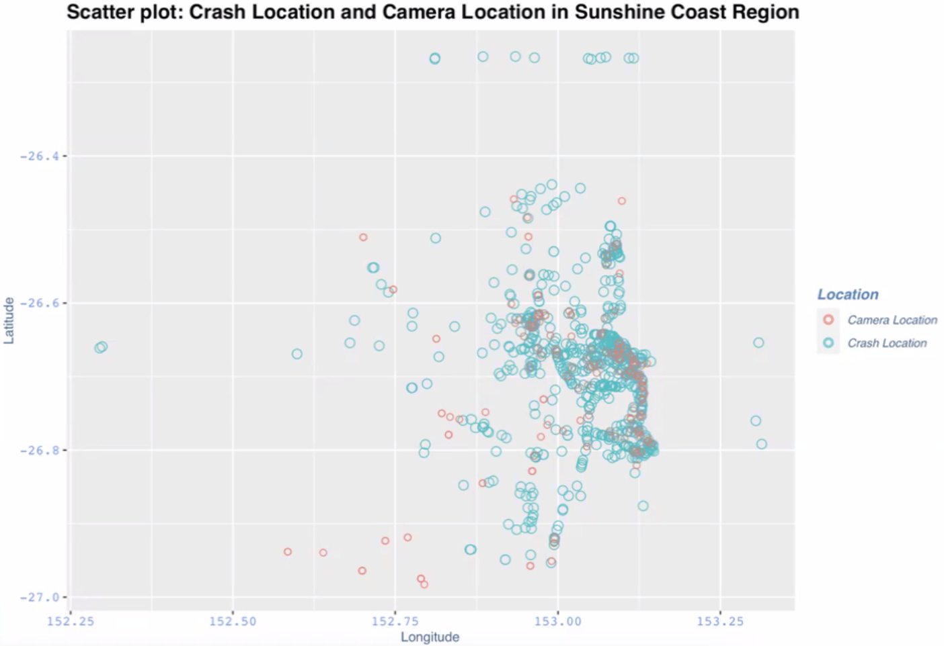
Speed Camera and Crash Location Mapping
in Local Area Government
In the Sunshine Coast Region, it is apparent that cameras are present in some locations where crashes occur, yet many incidents of crashes still transpire without any camera coverage. On the other hand, there are areas where cameras exist, but no accidents have been recorded.
Sunshine coast region: N: -26.432195, 152.966377 E: -26.801726, 153.150790 S: -26.984769, 152.985184 W: -26.703135, 152.551100

Slide 19
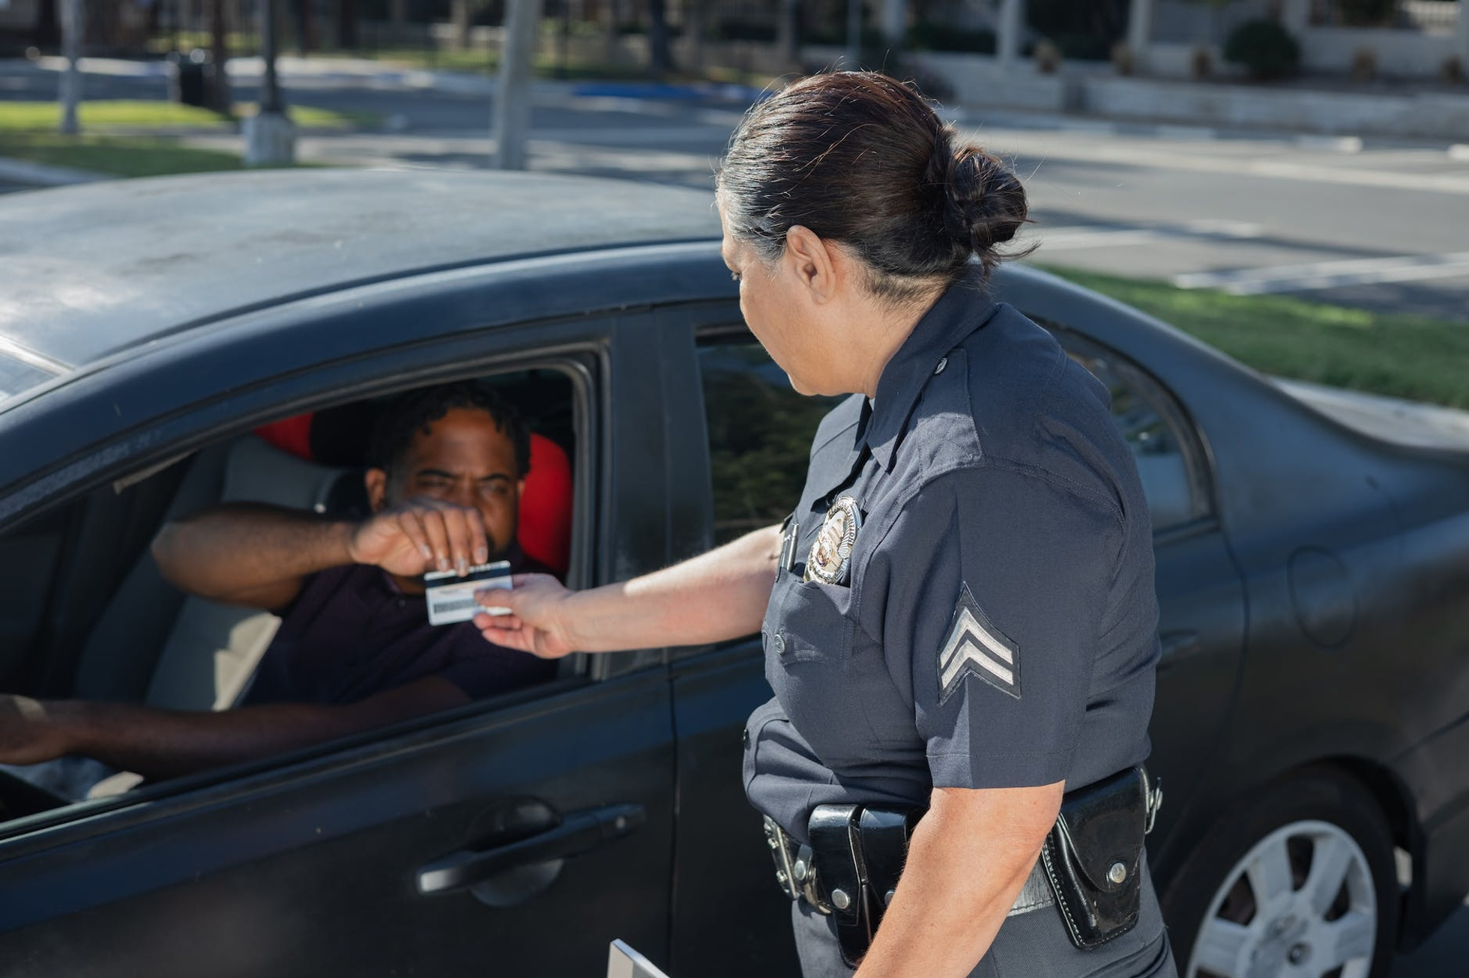
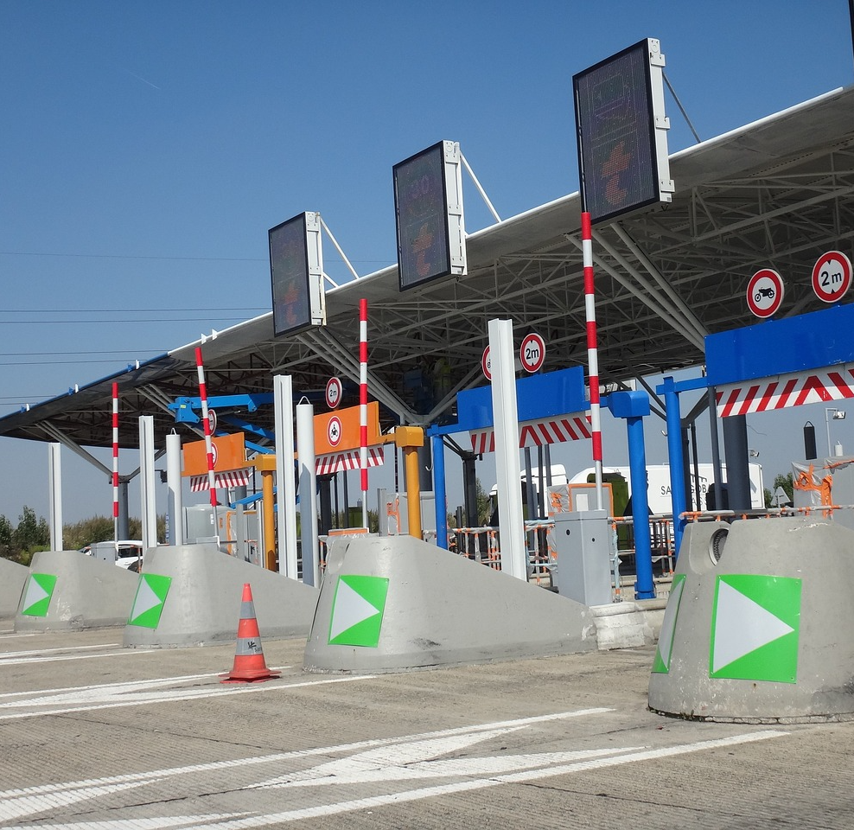
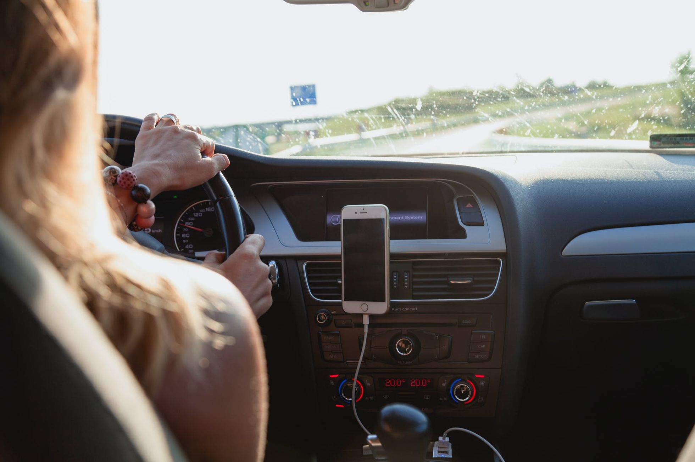
Regression Analysis
Calcultate regression to identify which offense categories have the strongest relationship with outstanding balance
Speeding, Tolling, and Driving
significantly related to the outstanding balance, with p-value (0,0006; 0,0083; 0,0222) respectively.
Tolling, Speeding, Parking
significantly related to the number of debts, with p-value (0,0008; 0,0054; 0,0483) respectively
only 31,86% contribution of all the offenses can explain the outstanding balance and 38,02% to the number of debts
adding more offenses to the model did not improve the model's explanatory power

Slide 20
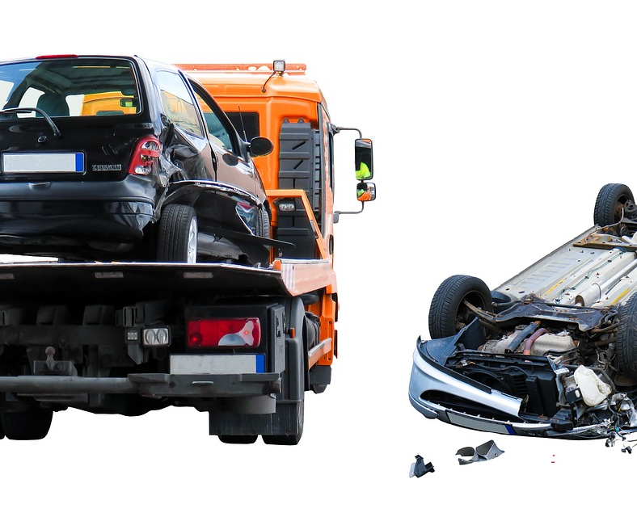
using poisson regression
Results
Drinking driving, driver speed, fatigued driver, and defective vehicle are significant factors of the car accidents

Slide 21

The main causes of car accidents in Queensland in 2021 are Speeding, Tolling, and Driving
The most significant factors contributing to the SPER Debt in SA4 regions are
Speeding, Tolling, and Driving
The installation of speed cameras may not necessarily lead to a decrease in the number of crash accidents in certain regions.
simply installing speed cameras may not be a comprehensive solution to reducing the number of accidents, and other factors must be considered.

Slide 22
Suggestions
Government
Traffic Police
Drivers
Public
Insurance Company
- Invest in improving road conditions.
Public
- Report incidents of reckless driving, defective vehicles, and road hazards.
Traffic Police
- Increase random breath tests and roadside checks to curb drink-driving.
- Implement stricter laws and regulations to ensure that drivers adhere to traffic rules.
- Encourage the adoption of new technologies such as automated vehicles.
- Educate on the importance of safe driving practices.
- Enforce speed limits and ensure that drivers adhere to traffic rules.
Drivers
Insurance Company
Government
- Adhere to traffic rules.
- Avoid driving after alcohol or drugs.
- Ensure vehicles are in good condition.
- Take regular breaks during long drives to prevent fatigue.
Offer discounts to drivers who adhere to traffic rules and have a good driving record.
-Incentivize regular vehicle servicing to promote safe driving behaviour.

Slide 23

Thoughts? Questions?
Open the floor to feedback and discussion.

